Slide 1
Data Wrangling and Data Analysis
Data Visualization
Department of Methodology & Statistics
Utrecht University

Slide 2





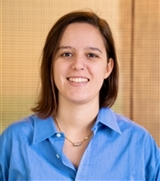




Social & Behavioural Science team
Erik-Jan
e.vankesteren1@uu.nl
Ayoub
a.bagheri@uu.nl
Daniel
d.l.oberski@uu.nl
Timo
timo_kuil@hotmail.com
Hanne
h.i.oberman@uu.nl
Elena
e.candellone@uu.nl
Jelle
j.j.teijema@uu.nl
Özgür
o.togay@uu.nl
Mahdi
m.shafieekamalabad@uu.nl
Thom
t.b.volker@uu.nl

Slide 3
Data Visualization - examples

Slide 4
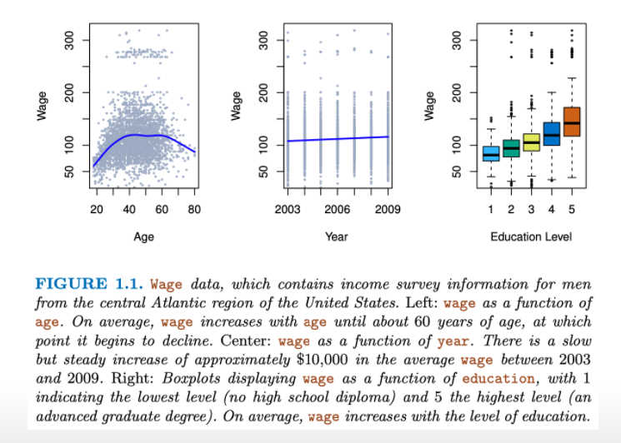
How do wages differ?
https://www.statlearning.com/

Slide 5
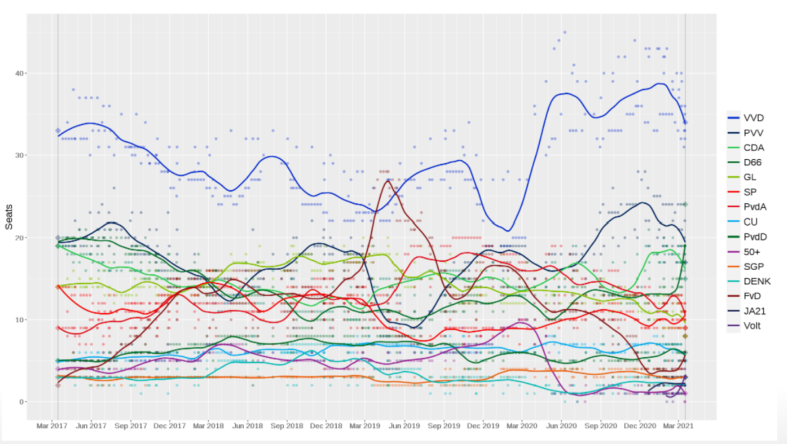
Predicting the outcome of the 2021 Dutch election
https://gitlab.com/gbuvn1/opinion-polling-graph

Slide 6
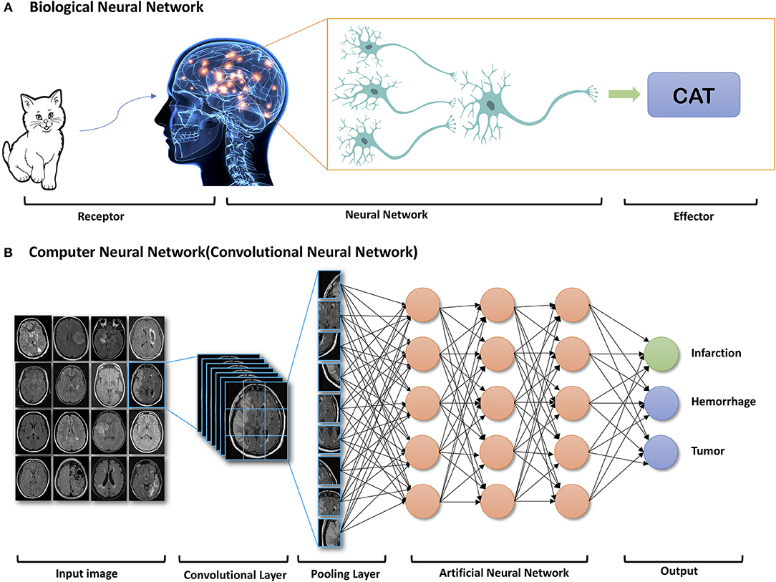
Deep Learning techniques

Slide 7
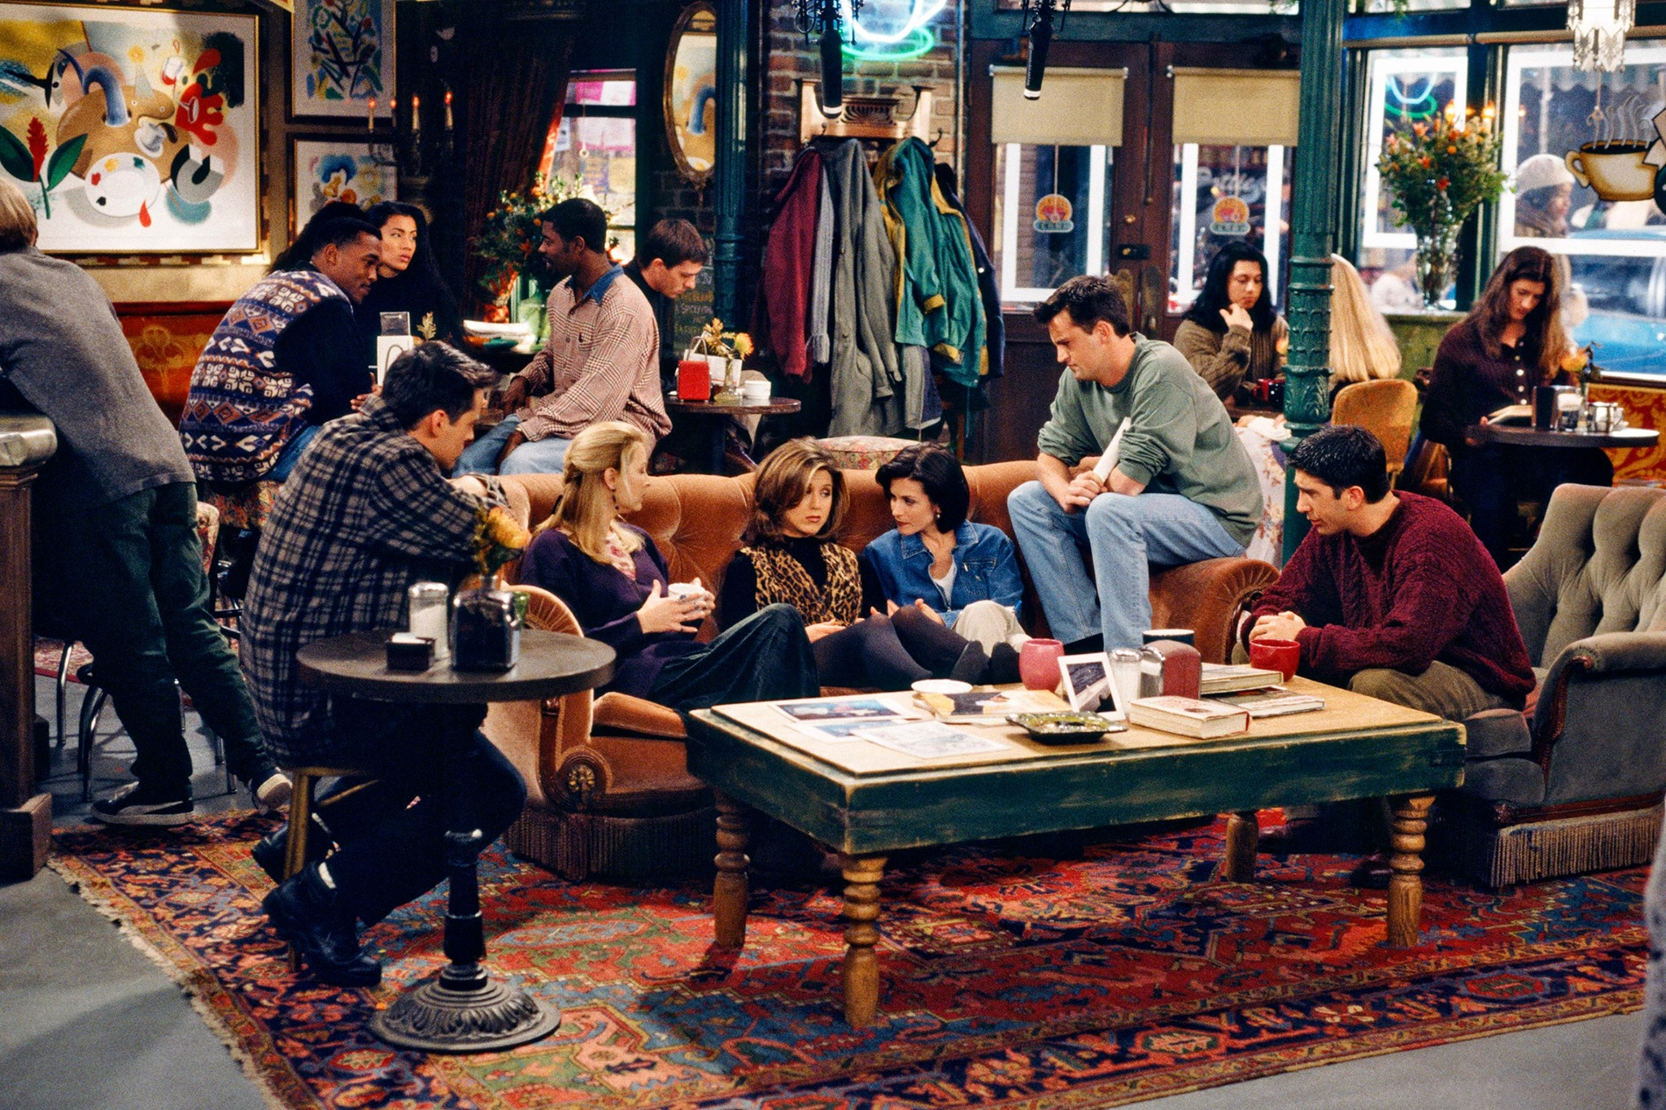
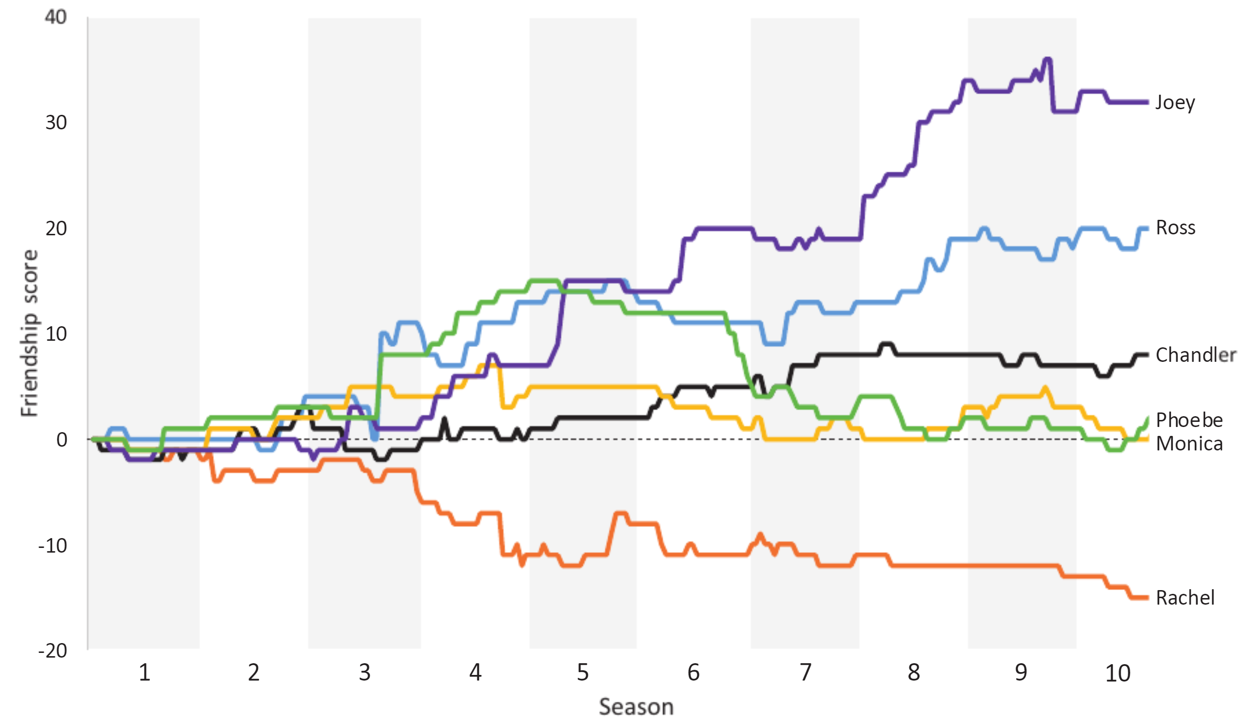
Who was the best Friend?
https://rss.onlinelibrary.wiley.com/doi/epdf/10.1111/1740-9713.01574

Slide 8
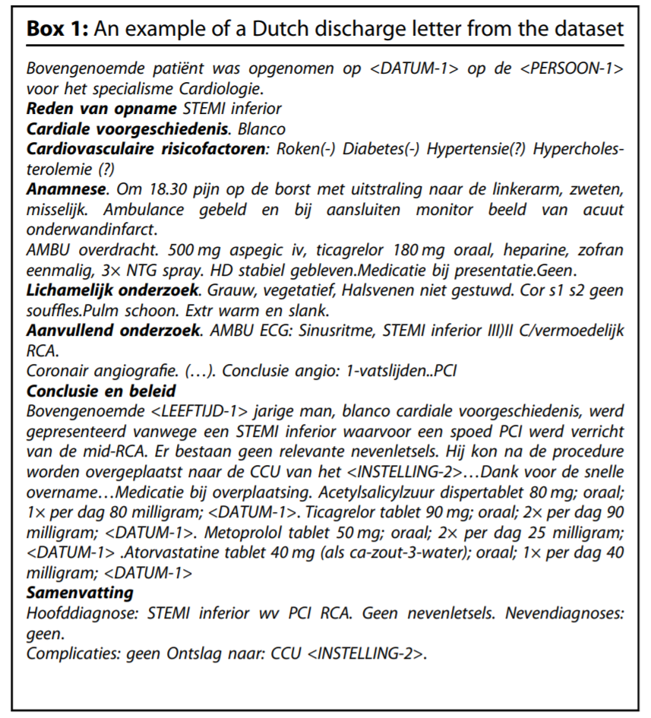
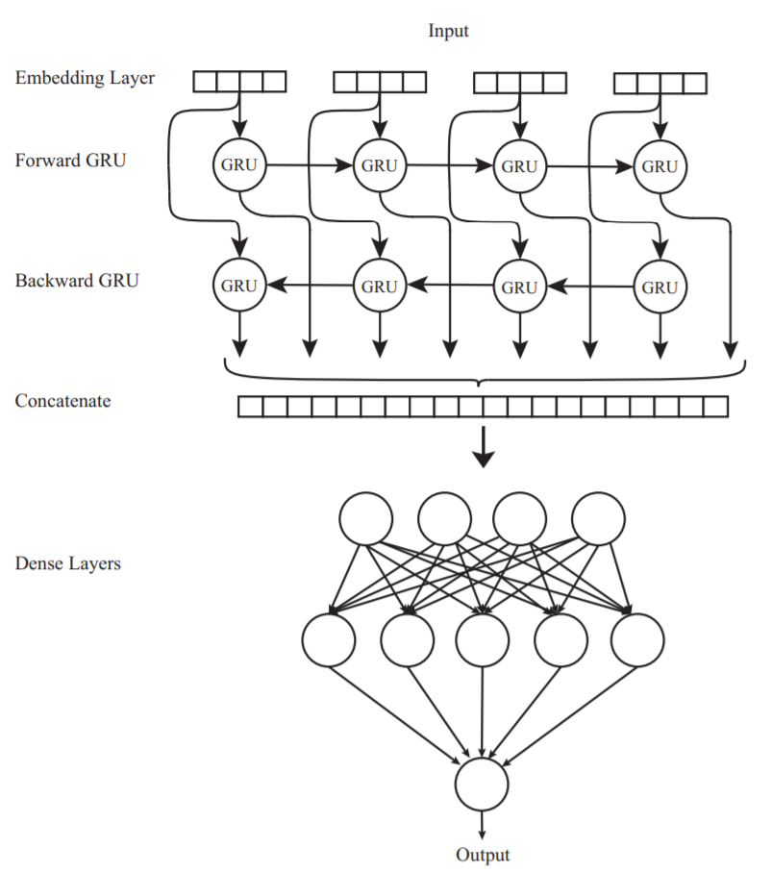
Automatic detection of ICD10 codes in cardiology discharge letters
https://www.nature.com/articles/s41746-021-00404-9

Slide 9
How to do R practicals

Slide 10
Schedule for the R practicals
Attendance is mandatory
In each session:
Q&A time for the lecture, short intro time for practical
Working on today’s practical (working together is allowed / encouraged)
~20 minutes discussion
Answers will be online during discussion

Slide 11
How to do R practicals
R practicals are on https://infomdwr.nl (like always!)
Sometimes they need some additional data
What steps to take?

Slide 12
Step 1: Create a folder with R project
Our suggestion: either
One folder for the course with an R project (.Rproj file)
Subfolder for each practical with .Rmd, .qmd, or .R file (depending on your preference)
Data folder with all data for all practicals
OR
One folder with .Rproj file per practical
Data folder per practical if needed

Slide 13
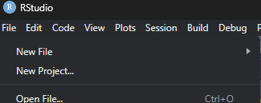
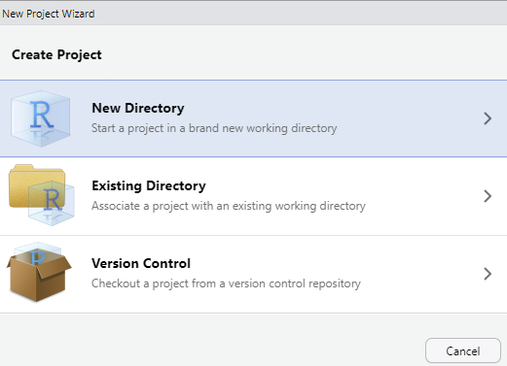
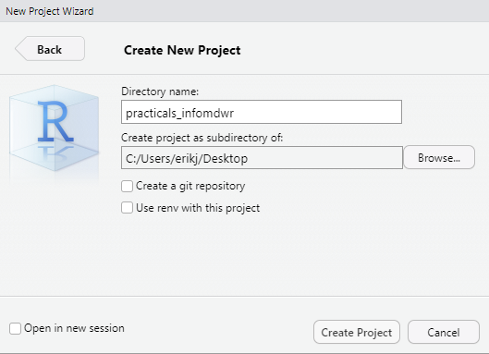
Step 1

Slide 14
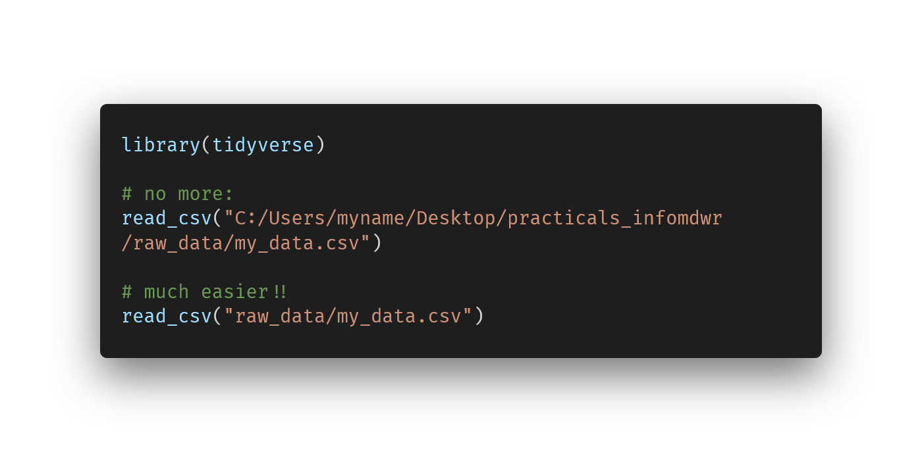
Now all file paths are relative!
For more info see R4DS chapter 7 https://r4ds.hadley.nz/workflow-scripts

Slide 15
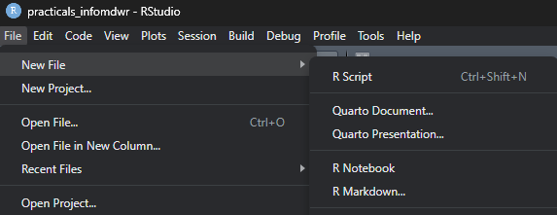
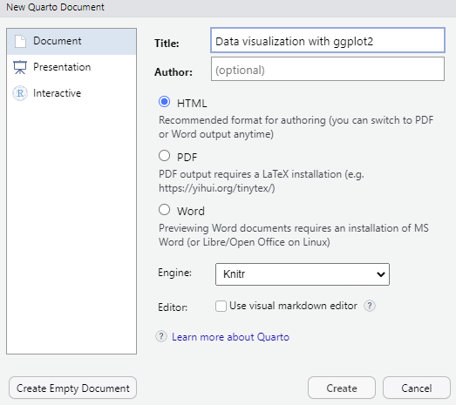
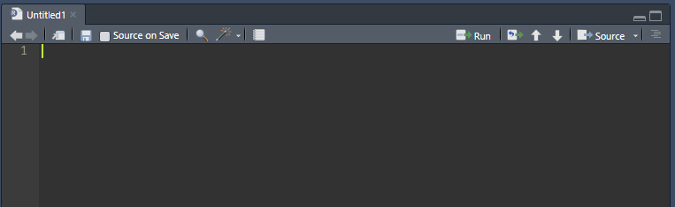


Step 2: qmd or .R file (or .rmd)
Notes:
Recommend an R script or a qmd file. Rmd only if they already know how to work with that (and then still qmd is better because it’s the successor).

Slide 16
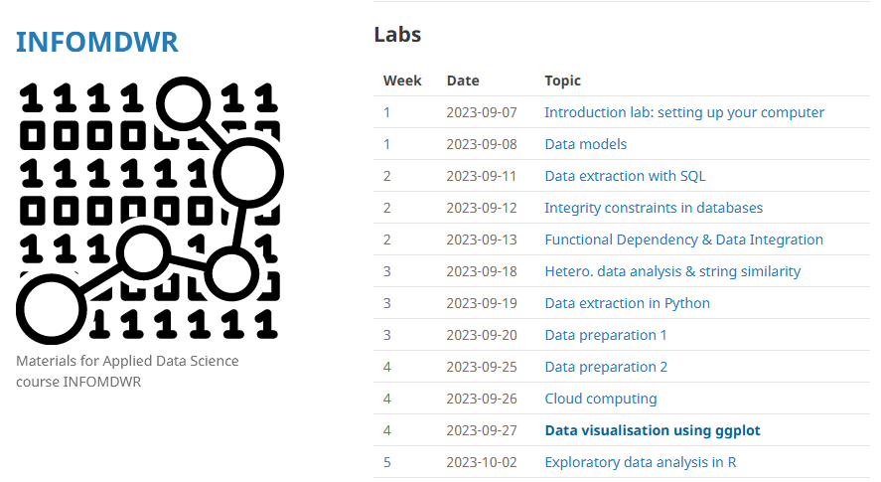

Step 3: Open the practical
Click on the url in the browser
Follow along and type your answers in your chosen file type

Slide 17
Any questions?

Slide 18
Data visualization using ggplot2

